Slide 1
British Airways
User Experience Analysis

Slide 2
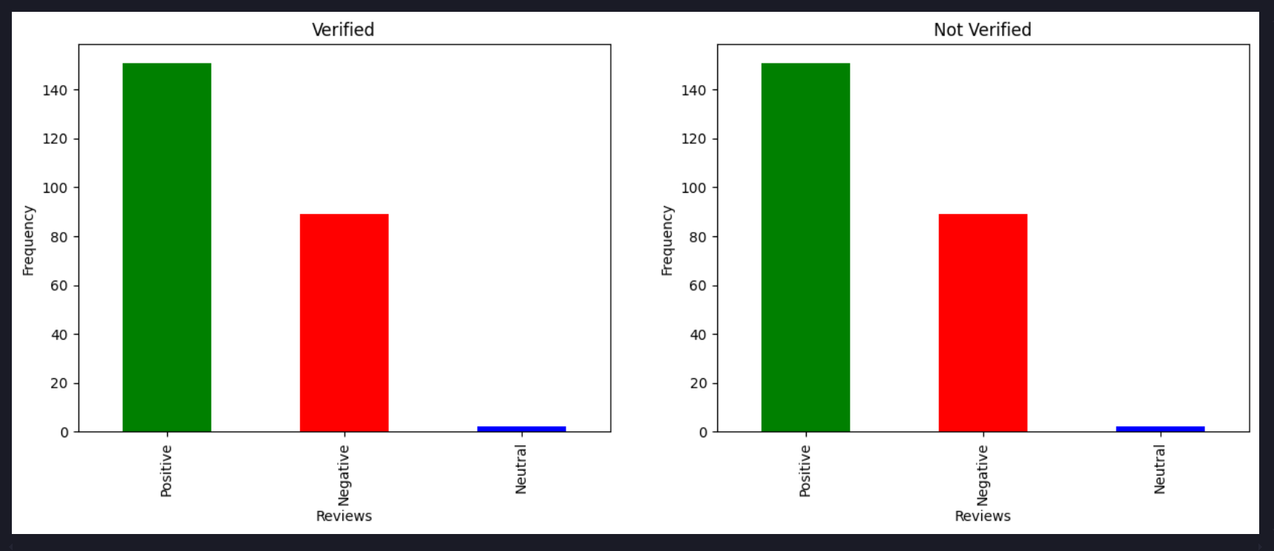
User Reviews Analysis

